Slide 1
Azure Infrastructure as Code Bootcamp
High Availability and Fault Tolerance

Slide 2

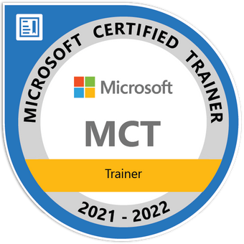


Tim Warner
timothywarner316@gmail.com
@TechTrainerTim
timw.info/linkedin

Slide 3
Course Agenda
Day 1
High Availability in Azure Storage
Day 2
High Availability in Azure Compute
Day 3
Global Availability in Azure

Slide 4
Day 1: High Availability in Azure Storage

Slide 5
Day 1 Learning Goals
Availability and Fault Tolerance in Azure
Availability in Azure Storage Accounts
Implement High Availability in Azure SQL Databases
Implement High Availability in Cosmos DB

Slide 6
Course Materials
timw.info/inebootcamp

Slide 7
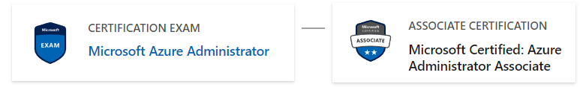
Relevant Microsoft Certification
AZ-104

Slide 8
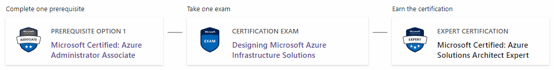
Relevant Microsoft Certification
AZ-104
AZ-305

Slide 9
Foundational Concepts

Slide 10
High Availability vs Fault Tolerance
Highly available environments have zero downtime at higher cost
Fault-tolerant (resilient) environments have minimal downtime at lower cost
Reference: timw.info/hfn

Slide 11
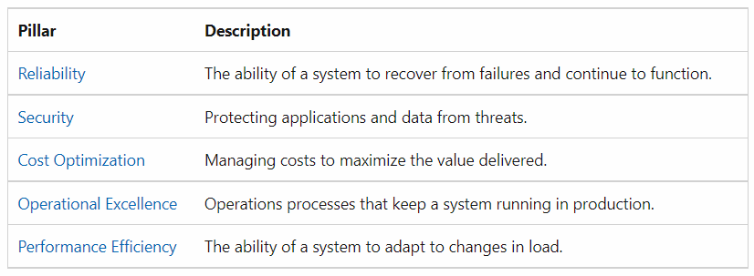
Azure Well-Architected Framework
Reference: timw.info/c3l

Slide 12
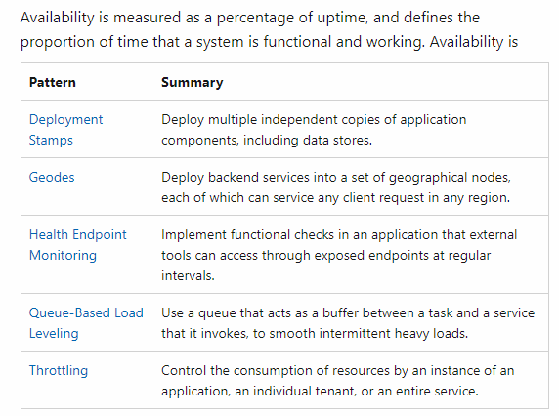
Availability Patterns
Reference: timw.info/z8h

Slide 13
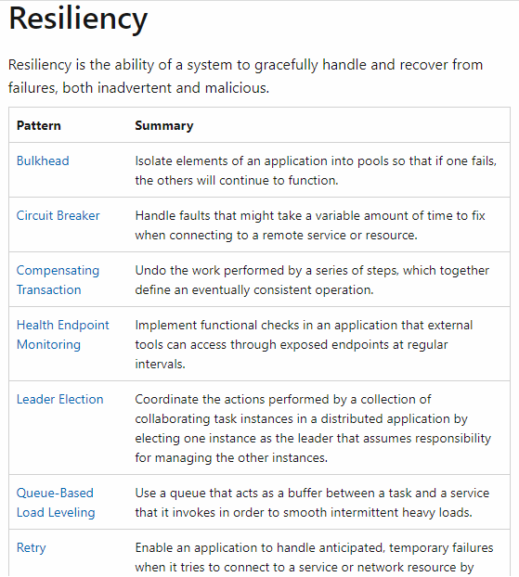
Resiliency Patterns
Reference: timw.info/z8h

Slide 14
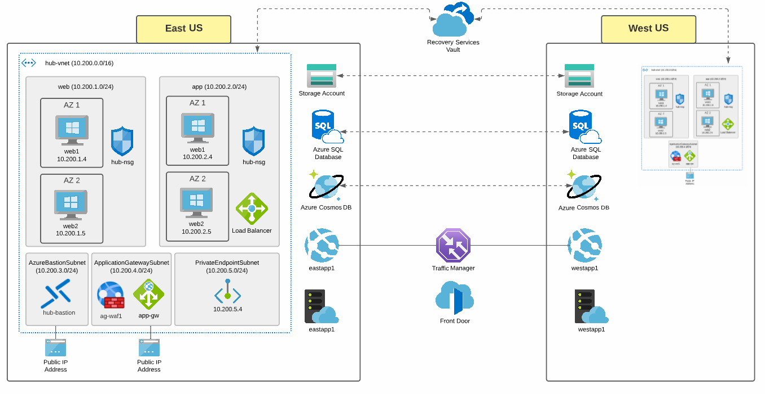
Class Reference Topology

Slide 15
Azure Storage

Slide 16
Storage Account Replication
1
3
3
2
LRS
ZRS

Slide 17
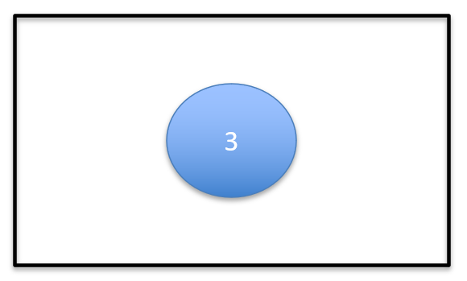
Storage Account Replication
1
3
1
3
2
2
GRS / RA-GRS

Slide 18
Storage Account Replication
1
3
1
3
2
2
GZRS / RA-GZRS

Slide 19
Azure SQL Database

Slide 20
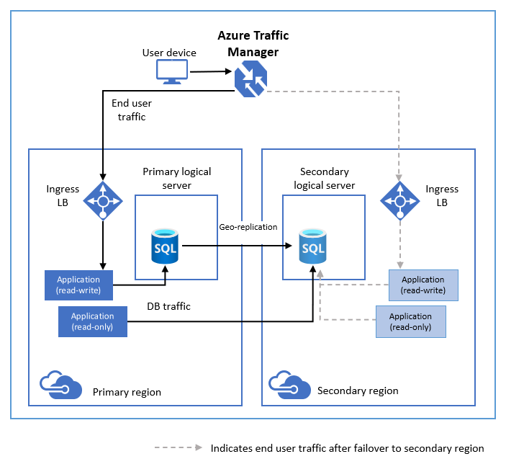
Azure SQL Database Geo-Replication
Reference: timw.info/iky

Slide 21
Azure Cosmos DB

Slide 22
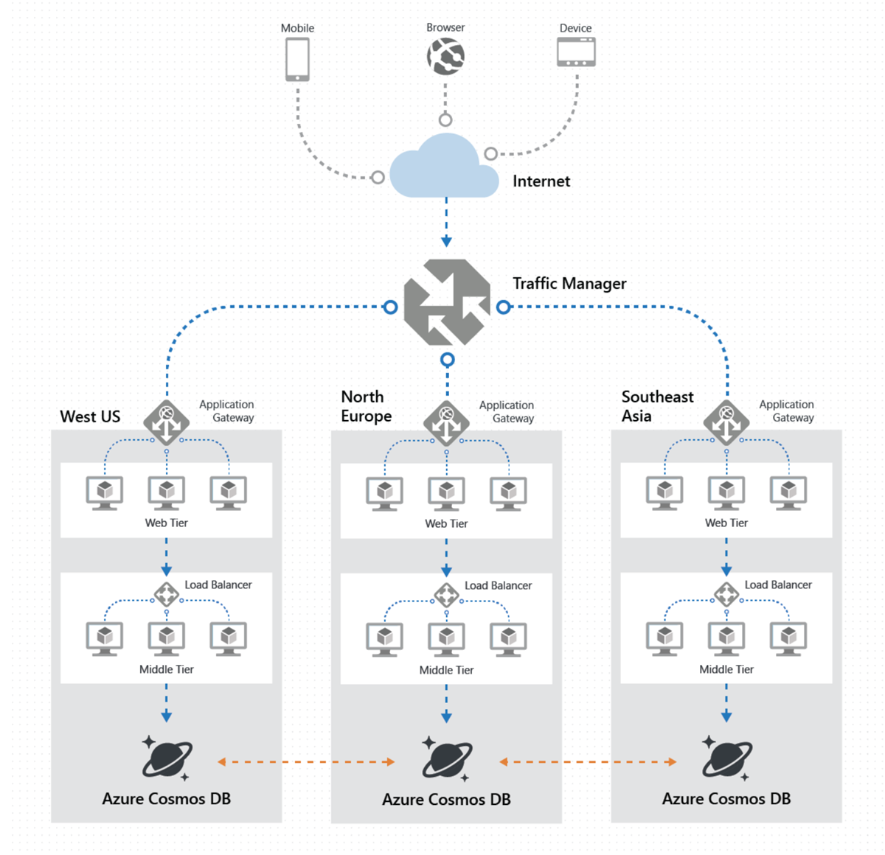
Cosmos DB Multi-Master Replication
Reference: timw.info/v5b

Slide 23
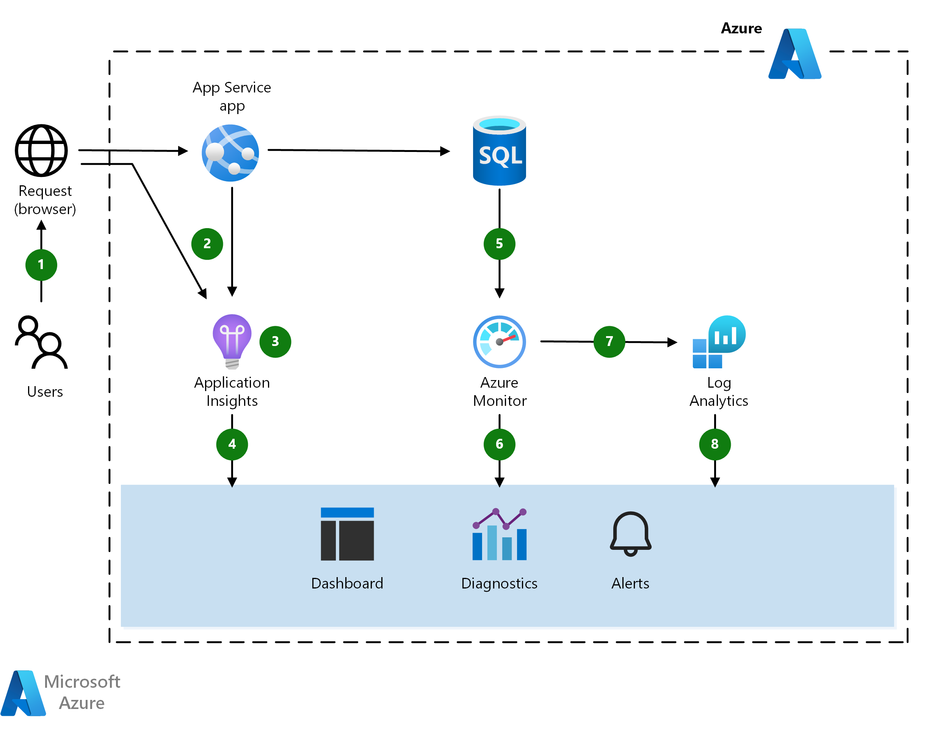
Monitoring and Alerting
Reference: timw.info/6ah

Slide 24
Looking Ahead to Day 2
Provision Virtual Machines in Specific Availability Zones
Implement an Azure Load Balancer
Use Azure Application Gateway to Implement Load Balancing
Configure an Azure App Service for High Availability
Provision a highly available Azure Kubernetes Service

Slide 25
Azure Infrastructure as Code Bootcamp
High Availability and Fault Tolerance

Slide 26
Day 2: High Availability in Azure Compute

Slide 27
Day 2 Learning Goals
Provision Virtual Machines in Specific Availability Zones
Implement an Azure Load Balancer
Use Azure Application Gateway to Implement Load Balancing
Configure an Azure App Service for High Availability
Provision a highly available Azure Kubernetes Service

Slide 28
Azure Compute Single Region High Availability

Slide 29
Azure Compute Services
Azure Virtual Machines
Azure Batch
Azure Kubernetes Service
Azure Service Fabric
Azure Container Apps
Azure App Service
Azure Functions
Azure Virtual Desktop

Slide 30

Availability Zones

Slide 31

Availability Sets

Slide 32
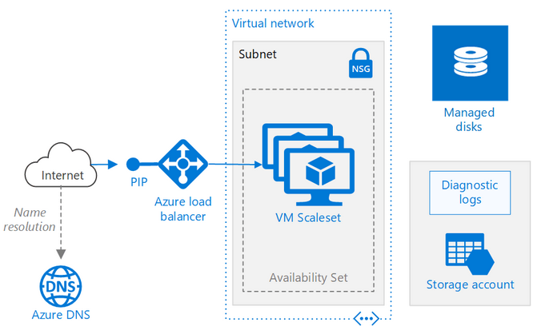
VM Scale Sets (VMSS)
Reference: timw.info/1z8

Slide 33
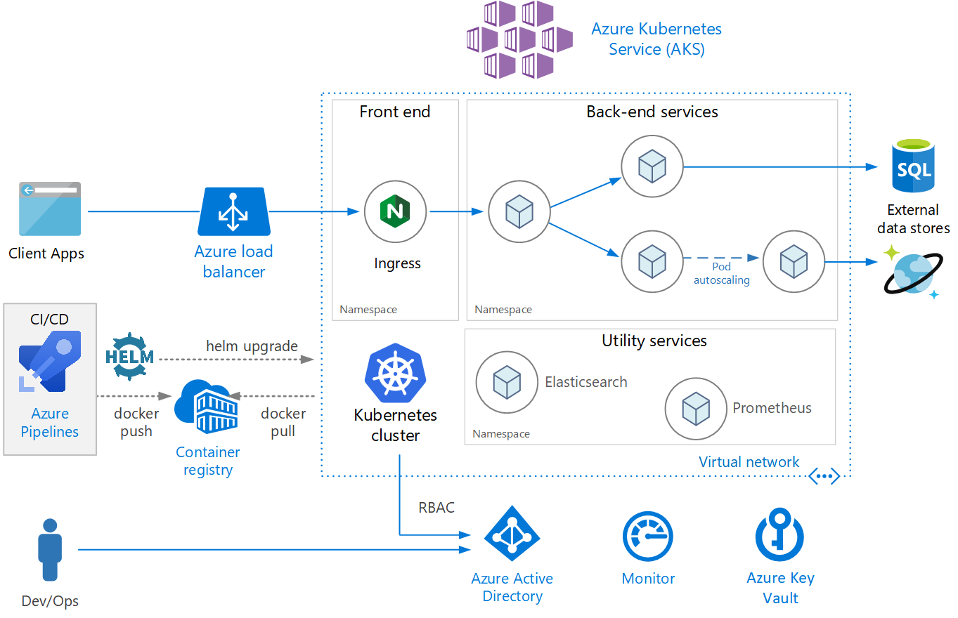
Azure Kubernetes Service (AKS)
Reference: timw.info/ti3

Slide 34

Azure Load Balancer

Slide 35
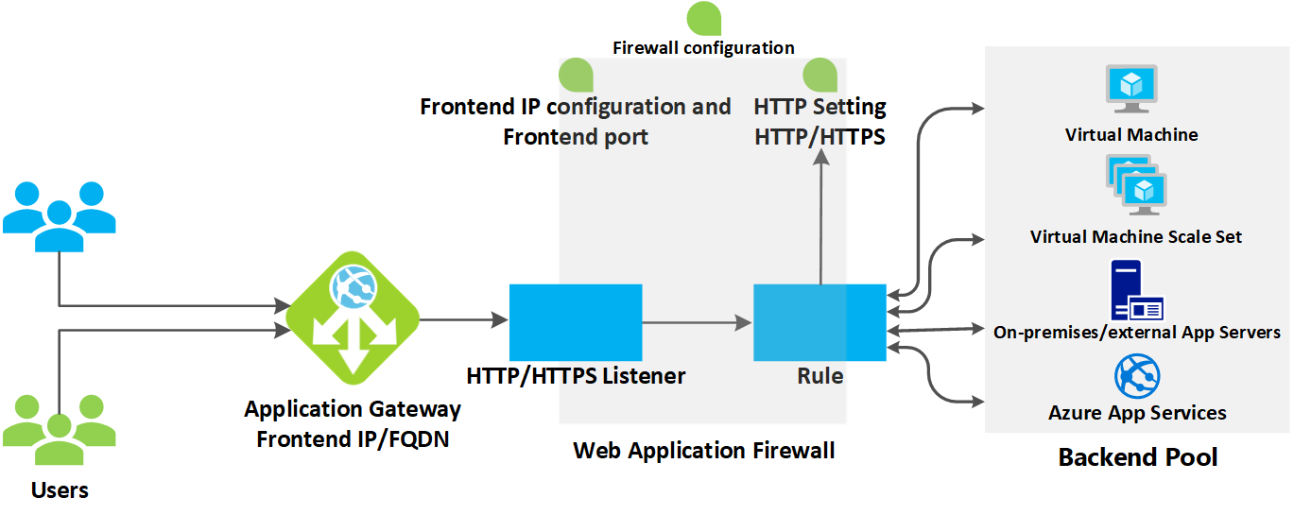
Azure Application Gateway
Reference: timw.info/wmt

Slide 36
Azure Compute Multi-Region High Availability

Slide 37

Azure Site Recovery (ASR)

Slide 38
Looking Ahead to Day 3
Build solutions with Azure Traffic Manager
Cross-Region Load Balancing with Azure Load Balancer
Build Global Solutions with Azure Front Door

Slide 39
Azure Infrastructure as Code Bootcamp
High Availability and Fault Tolerance

Slide 40
Day 3: Global Availability in Azure

Slide 41
Day 3 Learning Goals
Build solutions with Azure Traffic Manager
Cross-Region Load Balancing with Azure Load Balancer
Build Global Solutions with Azure Front Door
Evaluation (10 mins)

Slide 42
Azure App Service
Reference: timw.info/blah

Slide 43
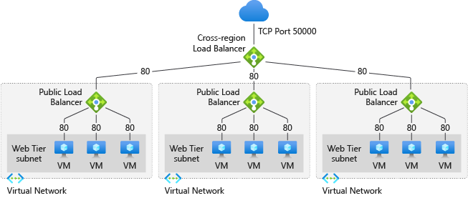
Cross-Region Load Balancer
Reference: timw.info/qq7

Slide 44
Title
Reference: timw.info/blah

Slide 45
Demo

Slide 46
Course Evaluation
timw.info/ineeval

Slide 47
Thanks so much!
timothywarner316@gmail.com
@TechTrainerTim
timw.info/linkedin

